Slide 1
Groovy Scripting

Slide 2
Static programming language
Dynamic programming language
Closure programming

Slide 3
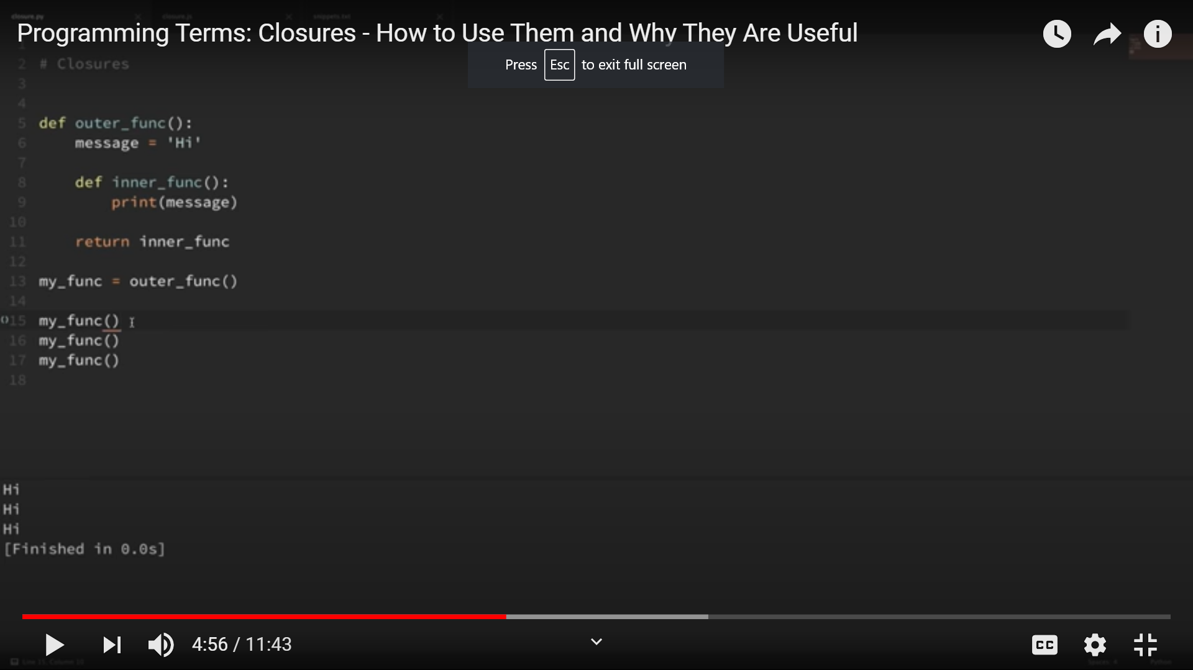

Slide 4
myClosure()
def myClosure = {
a,b,c-> it represesents parameter and the arrow represents y = a+b+c
return y;
}
myClosure(1,2,3)

Slide 5
Features of Groovy
Support for both static and dynamic typing.
Native syntax for lists and associative arrays.
Native support for regular expressions.
Native support for various markup languages such as XML and HTML.
Provides usage of existing Java libraries.

Slide 6
Difference in java and groovy
java-syntax compatible OOP for java platform
Can be used as programming language as well as scripting language
Source code gets compiled into Java Bytecode so it can run on any platform that has JRE is installed.
It is designed as a companion, not a replacement for Java
A superset of java

Slide 7
Some general purpose packages and classes are imported by default but in Java only java.lang.* package imported by default.
Variables are defined using the keyword "def," and the type of a variable does not need to be declared in advance. The compiler figures out the variable type at runtime
Default access modifier-public in java
Behaviour of ==
If you want to write a multiline string: “ “ “ vvvvvvvv” “ “
Groovy traits:
ex:trait Marks{
void display(){
println(“hello”);}}

Slide 8
Annotations :
@interface:
Ex:@interface Simple{
String str1() default “Hello”}
@ClassType
ex::@interface Simple{}
@Simple
Class User{
String username;
int year;}
Def user=new User(username: ‘dipti’,year:’2020’);
println(user.username);

Slide 9
Groovy- Decision Making
if statement
if/else statement
nested if statement
switch statement
nested switch statement

Slide 10
Like java to run a for loop in groovy we use terms:
Upto: 0.upto(4) {println "$it"}
$it is a closure that gives the value of the current loop.
Times: 4.times{ print "$it" }

Slide 11
Groovy List
Holds a sequence of object references
ex: ['Groovy', 2,4 2.6]
List methods available in groovy
Add()
Contains()
Get()
isEmpty()
Minus()
Plus()
Pop()
remove()
Reverse()
Size()
Sort()

Slide 12
Groovy Maps
A Map Groovy is a collection of Key Value Pairs
Ex:[ Key1:’value1’]
[ : ] Represent an Empty map
Map methods in groovy:
containsKey()
Get()
keSet()
Put()
Size()
Values()

Slide 13
Groovy Tools
We will discuss 3 important tools
1. groovysh: Executes code interactively.
2. groovyConsole: GUI for interactive code execution
3. groovy: Executes groovy scripts. You can use it like Perl, Python, etc.

Slide 14
In DevOps:
used for unit testing Java code
Productivity increases
Advantages:
Simplicity of language
It’s dynamicity

